Slide 1

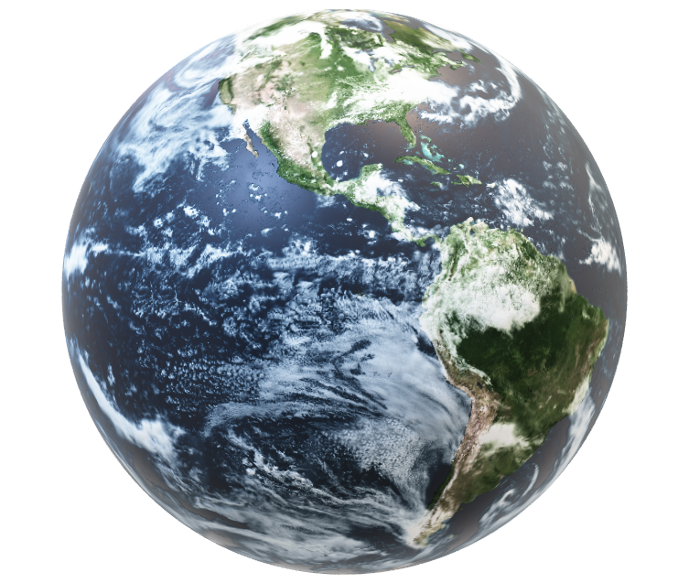
NAKSHATRA NAVIGATORS
Travel beyond horizons
Team members:-
Shreya Mandhre
Shruti Shende
Samiksha Girhale
Ashlesha Amrute
Aniket Patil

Slide 2

INTRODUCTION
Embark on a journey that will redefine your exploratory capabilities to multiplanetary and understanding infinite possibilities that lies beyond Earth.
We provide out of this world experience to our esteemed space sailors.
Today, we invite you to join us on this extraordinary journey, where the sky is not the limit, but only the beginning.
Together, we will chart a course from space tourism to multiplanetary travel,

Slide 3
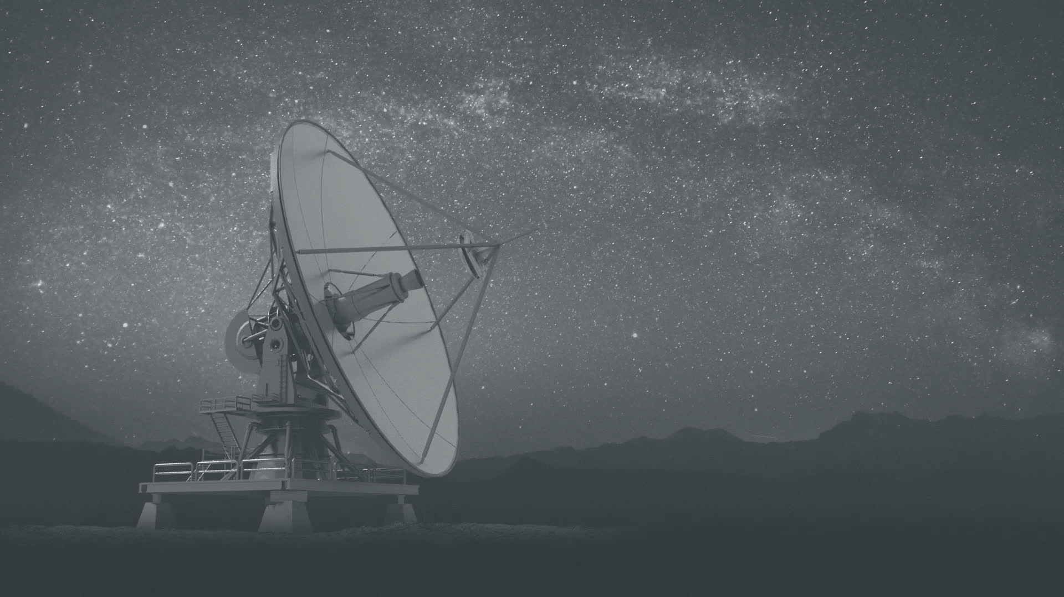
PROBLEM STATEMENT
Space tourism will certainly become commonplace for Earthlings in the far future, but space tourists will need assistance selecting a location and planning an itinerary.
Being a travel representative at a future space tourism bureau. Our task is to construct a program that will not only create individualized itineraries for travelers in the future who wish to see the major bodies in our solar system—possibly Mars, Jupiter, or Saturn—but also inform current users about the numerous diverse things in our solar system.

Slide 4
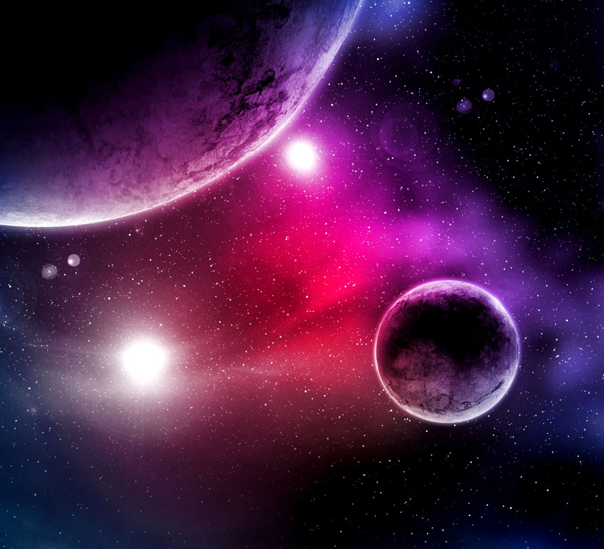
AIM AND OBJECTIVE
Aim is to create a tool that will not only develop customized itineraries for future travelers who want to visit the main bodies in our solar system but also provide information about different planets.
Our objective is to captivate people who wants to travel different planets and explore breathtaking scenes of different extreme environments as well as some of future habitable places other than Earth.

Slide 5
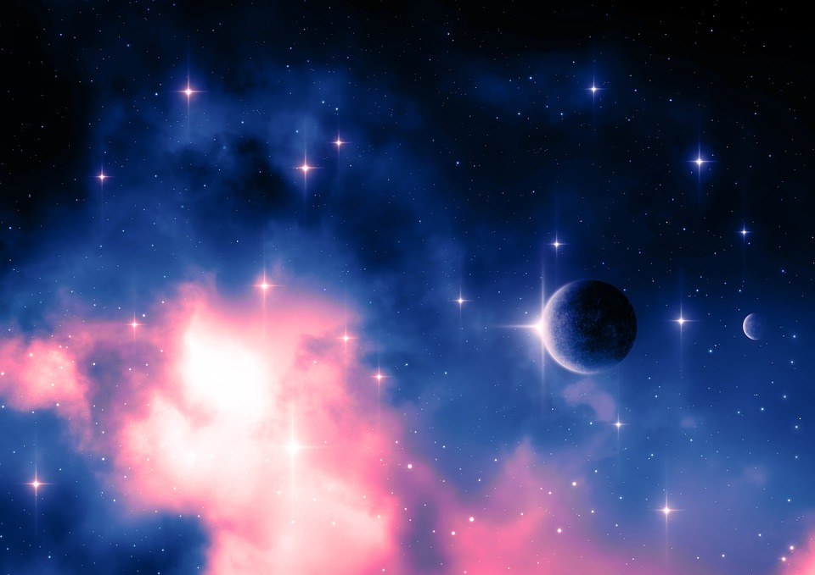







WORKFLOW
Selecting Destinations
Data Collection
Obtain 3d models & Images of planets
Creating Itineraries
Cost Calculations
Must Carry List
Designing Brochures
Design website
Host website

Slide 6
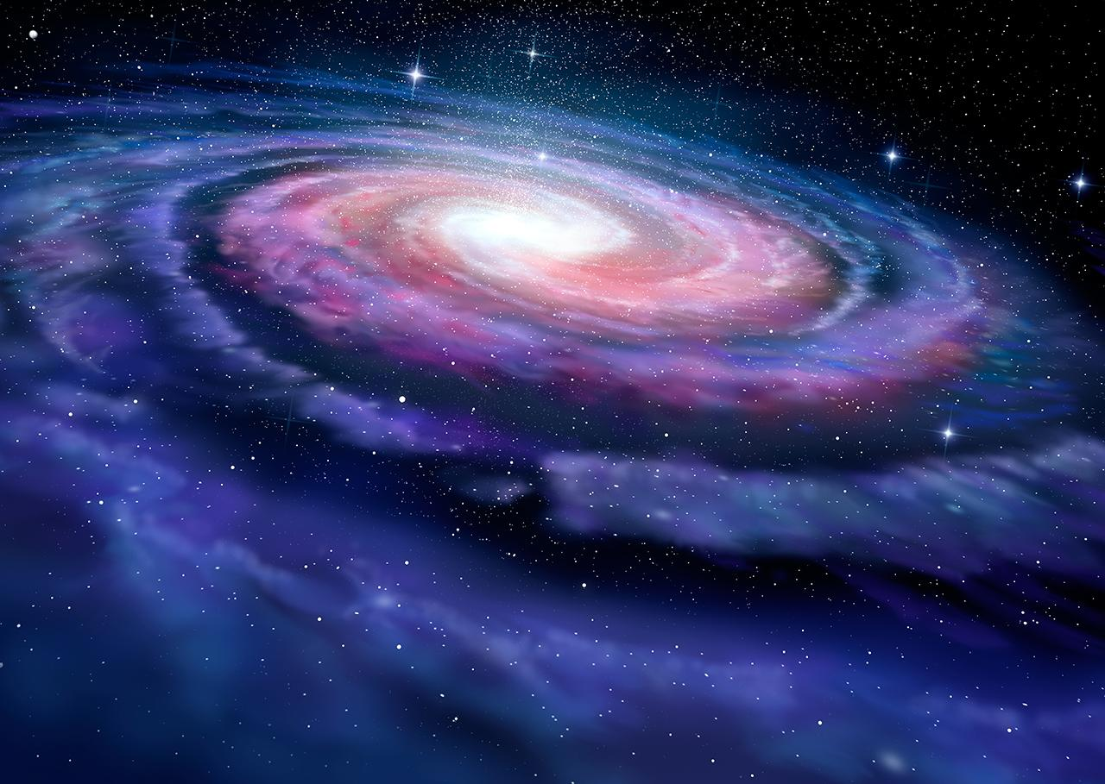
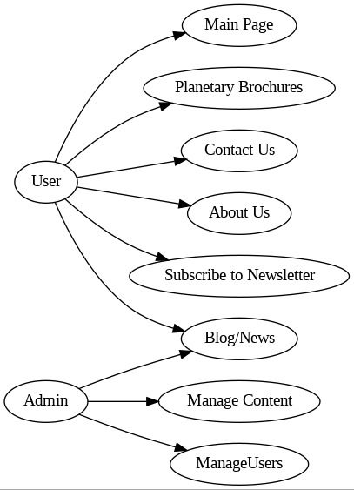
SYSTEM USE CASE

Slide 7
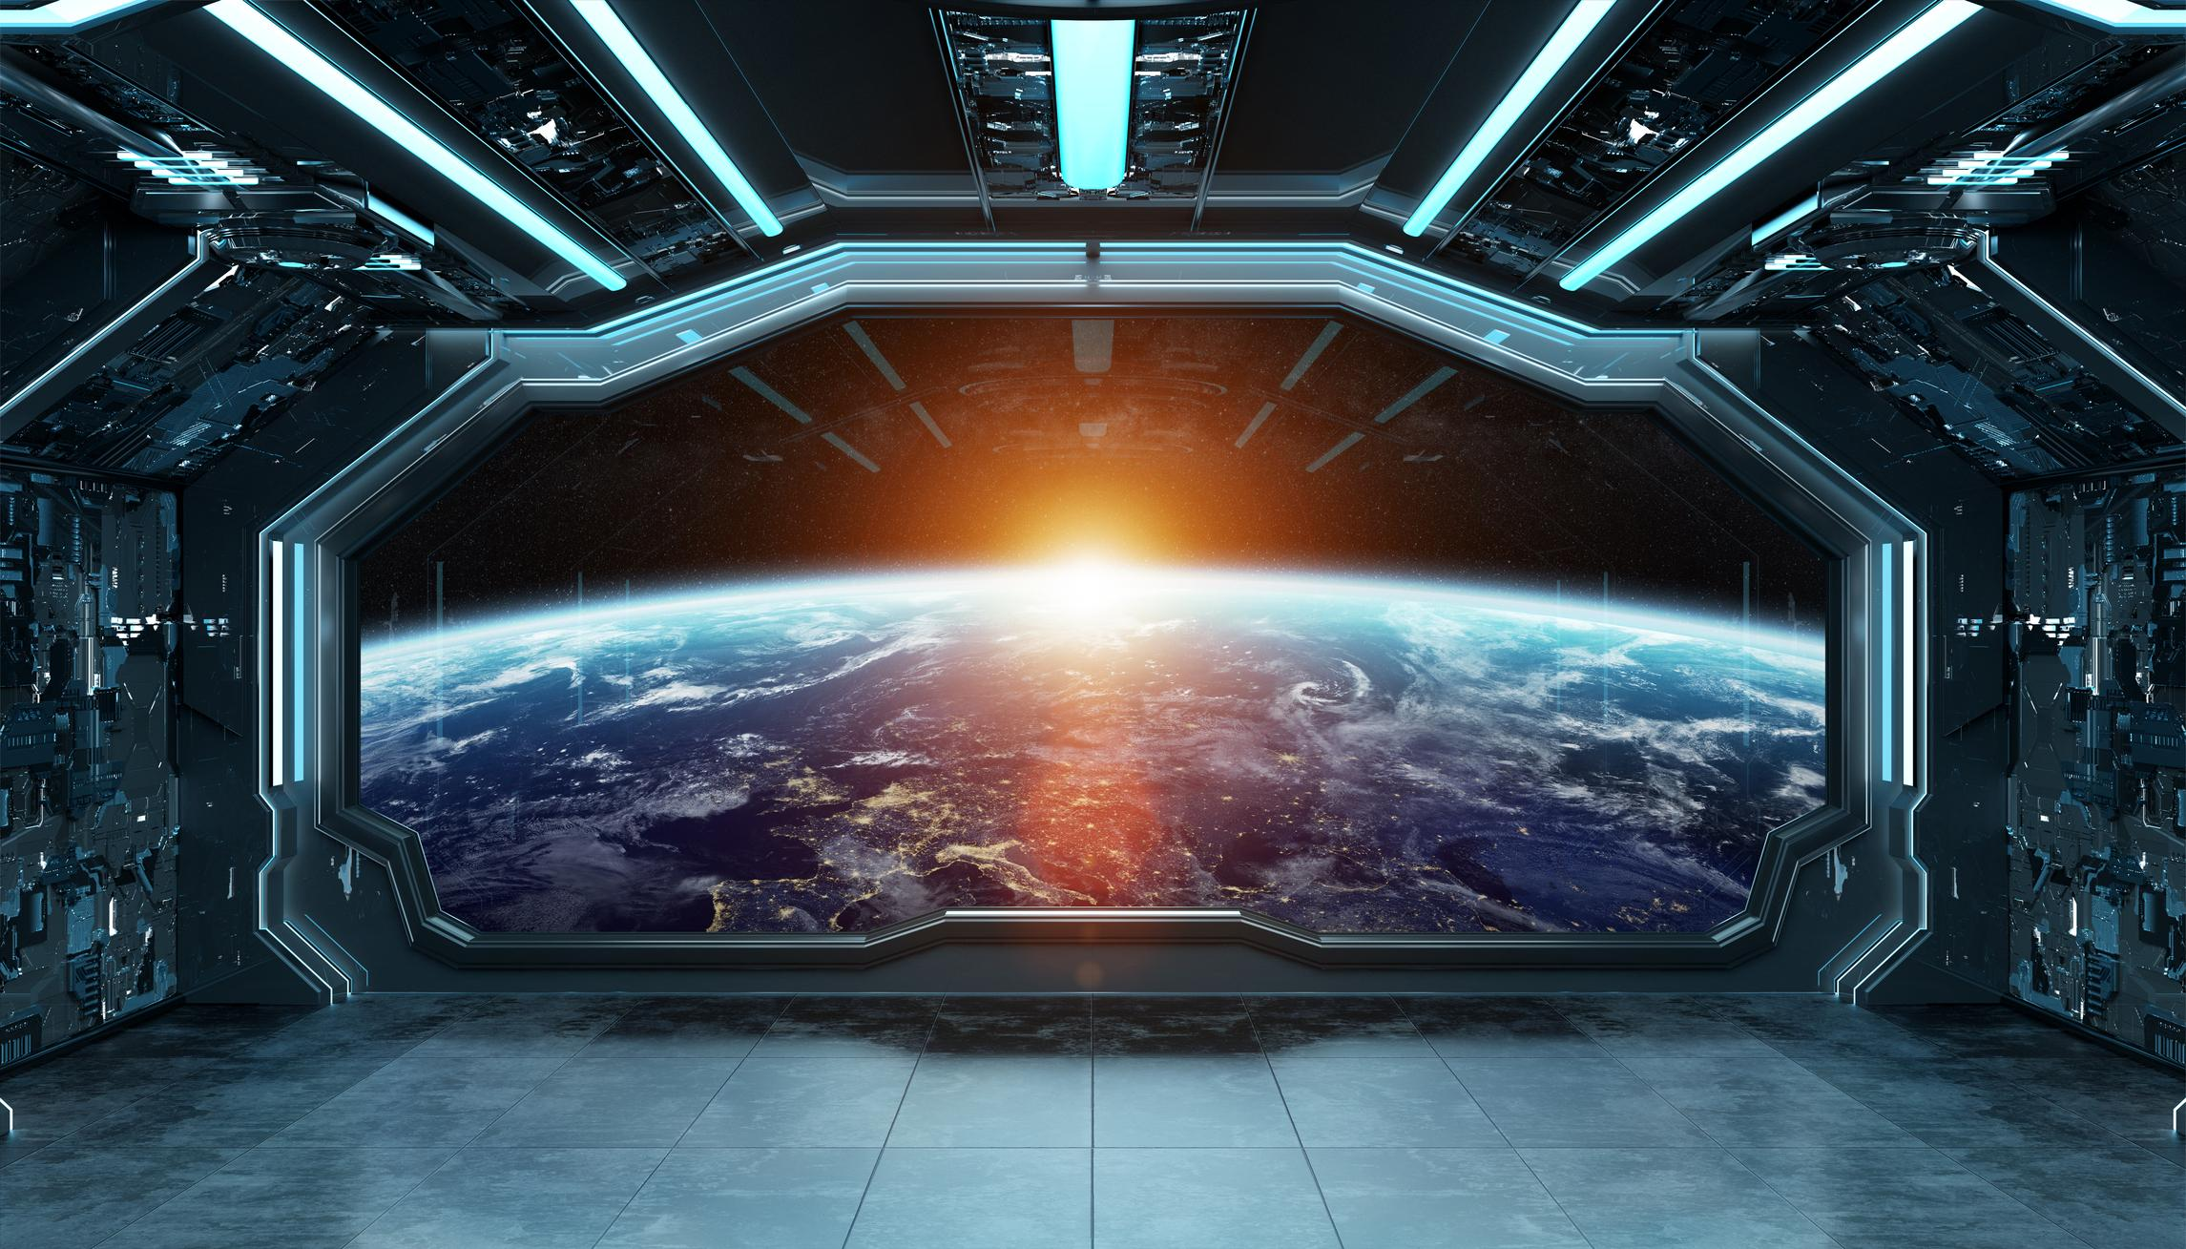




UNIQUE SELLING POINTS (USP)
3D MODELS
CUSTOMIZABLE TRAVEL PLAN
INTERACTIVE WEBSITE WITH ENGAGING CONTENT
TRAVEL
SUGGESTIONS

Slide 8
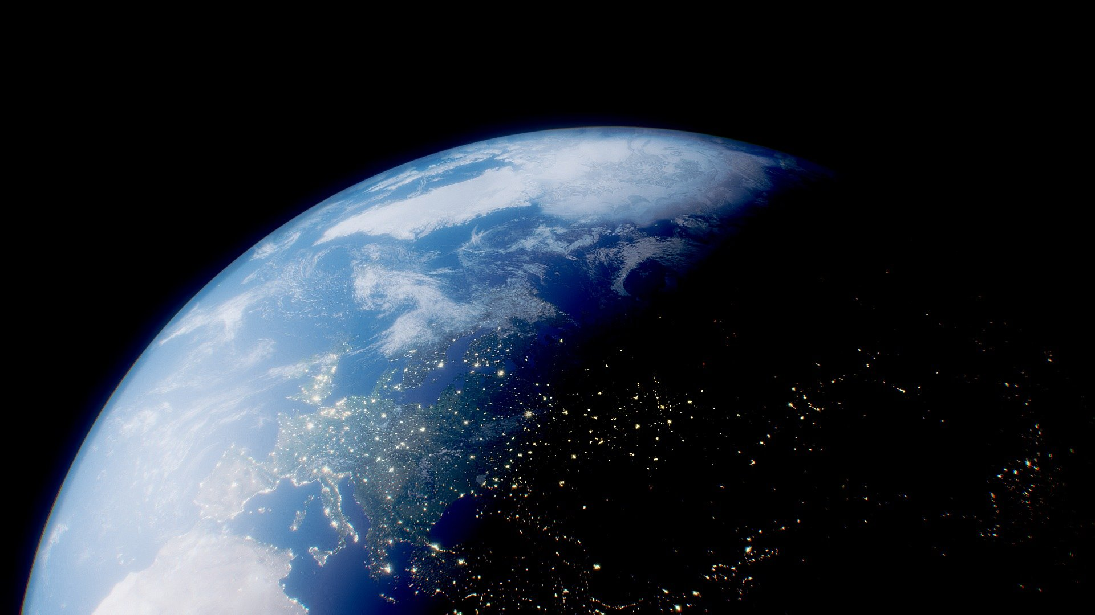


REFERENCES
Planets Images and 3D Models
https://science.nasa.gov/solar-system/resources/
GPS Time Calculation
https://www.researchgate.net/publication/278876018_goGPS_open-source_MATLAB_software

Slide 9

CONCLUSION
In conclusion, the planetary tourism project signifies an exhilarating era of human exploration and adventure. It unveils not only the thrilling possibilities of visiting other celestial bodies such as Mars and the Moon but also underscores the pressing need for technological advancements, ethical considerations, economic opportunities, and educational inspiration. The project paints a picture of a future where space travel becomes a reality, generating economic benefits, fostering scientific literacy, and captivating the imaginations of generations to come. However, it is crucial that we tread carefully, ensuring responsible practices and sustainability in our quest to venture beyond Earth's boundaries. With concerted efforts, planetary tourism has the potential to reshape our understanding of tourism and our place in the universe, inviting us to embark on a profound journey of discovery and wonder.

Slide 10
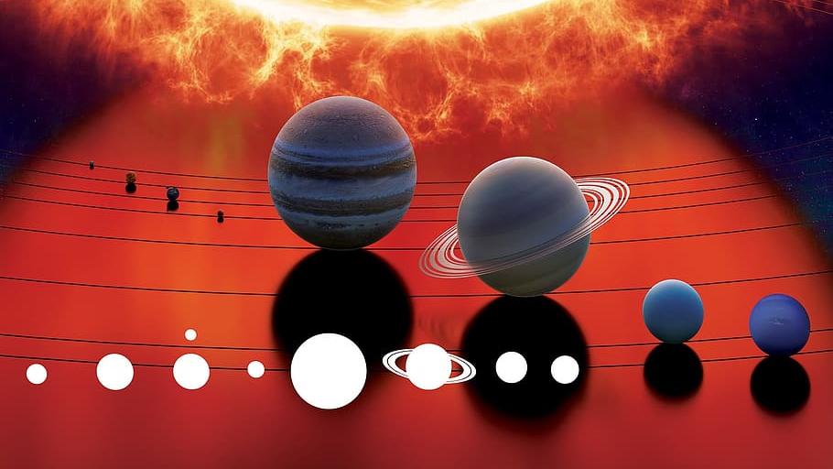
THANK YOU

